Slide 1

Intro to Jingo
The magical world of python publishing on the web!

Slide 2

Meet Django Pony

Slide 3
What is this this Django Magic?
Django is a Python Web Publishing Framework
Built by Journalists for rapid development of data-driven websites and web applications
Used at large and Small publications

Slide 4
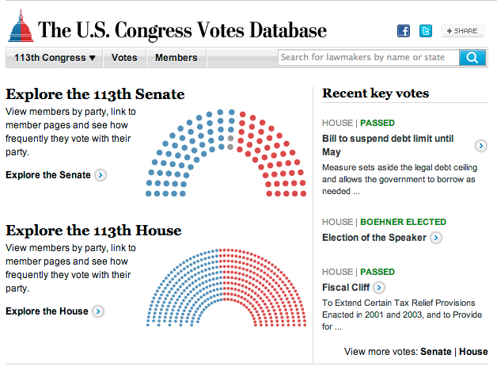
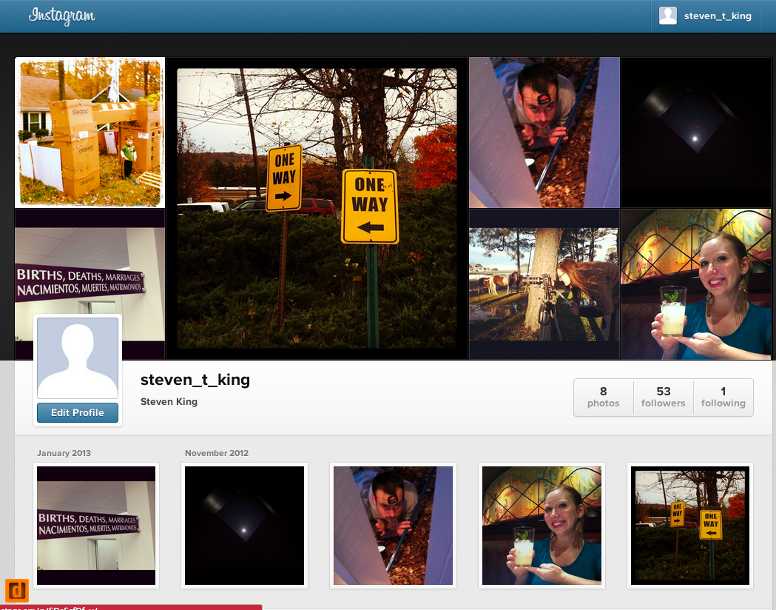
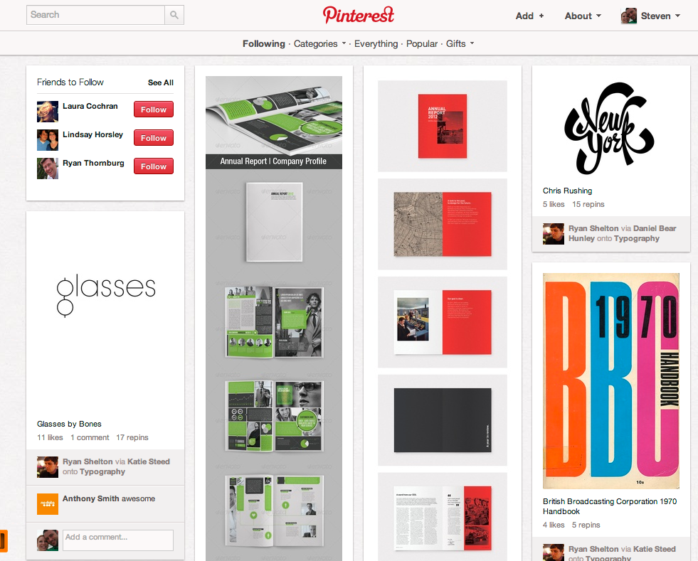
Who Uses it?
Washington Post
National Geographic
The Onion
Instagram
Pinterest

Slide 5
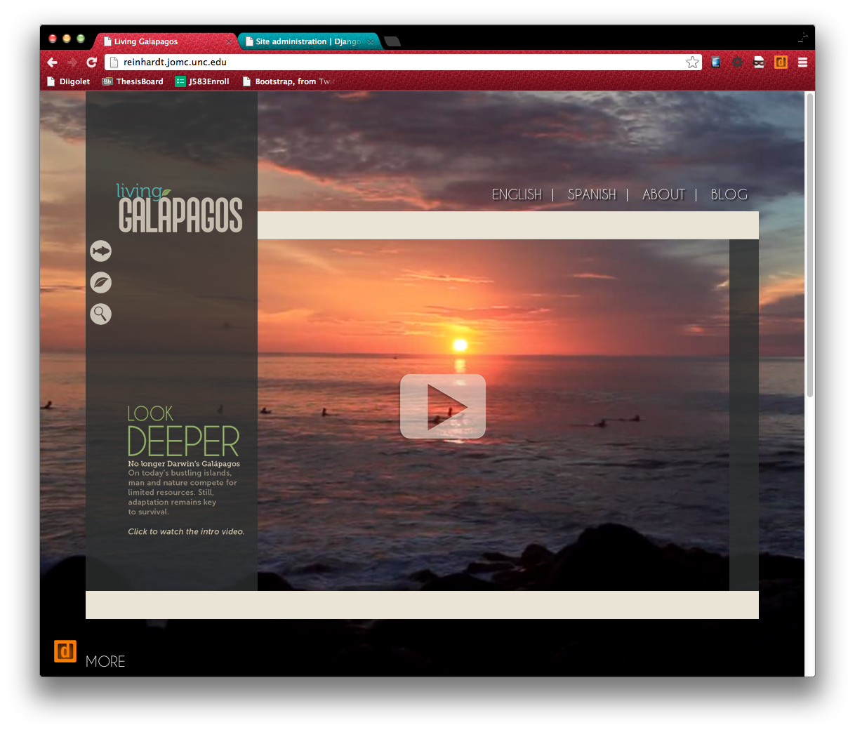
UNC Example

Slide 6
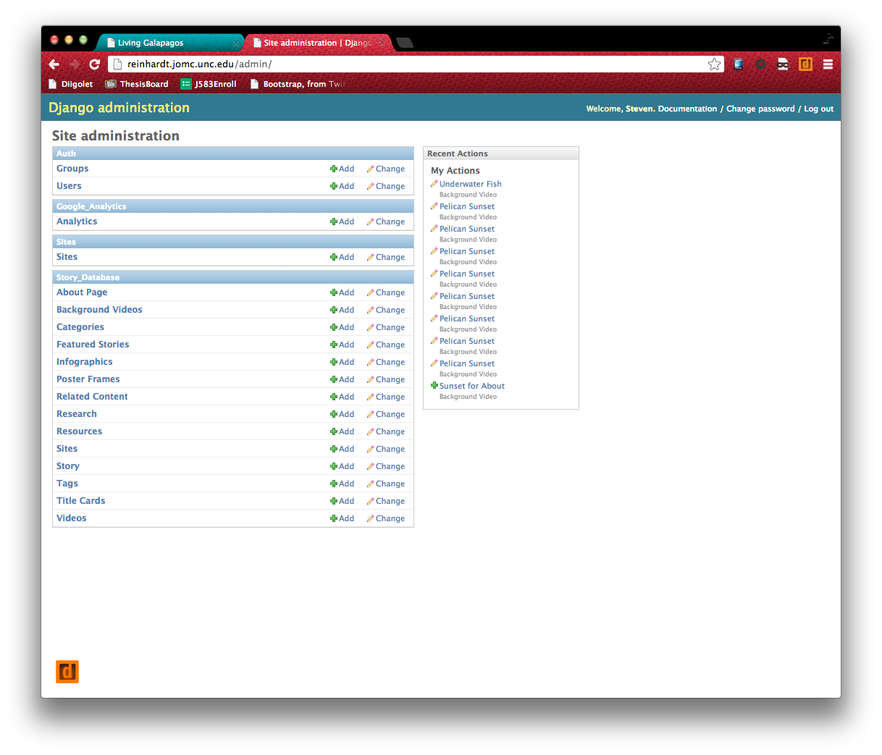
UNC Example

Slide 7
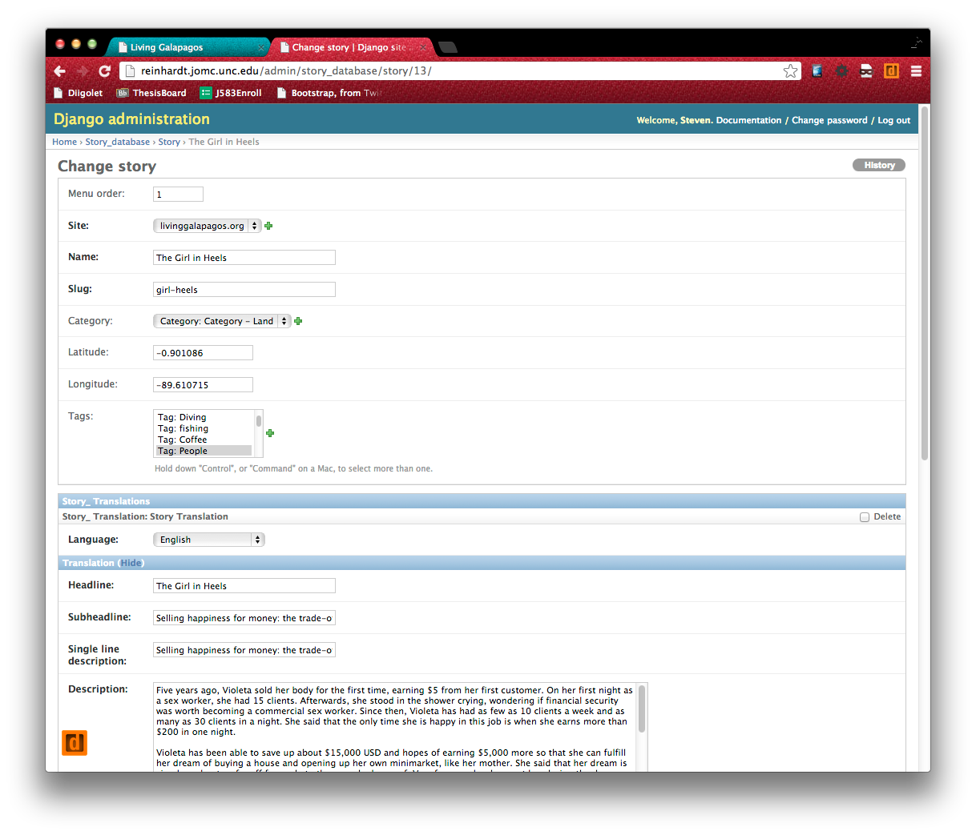
UNC Example

Slide 8
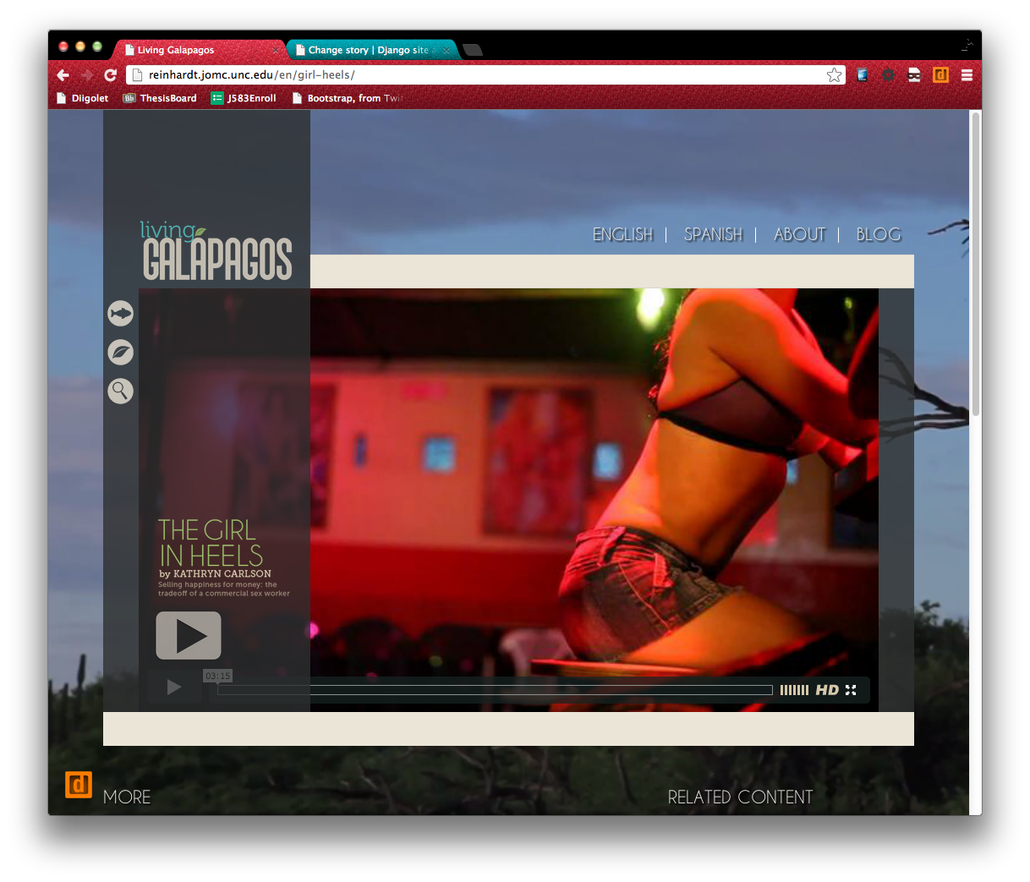
UNC Example

Slide 9
Overview of a Django Project
Project Source Code
External Applications
Static Resources
Media
Django Project
Web Server Config
Database Server Config
Deployment Tools
Monitoring

Slide 10
Let’s Make Magic!
Install easy_install, pip and virtual env
mkdir DJANGO_PROJECTS/dependencies
Easy Install
Go to: http://pypi.python.org/pypi/setuptools#downloads
mv that file to dependencies
Run the file as a Shell Script
sudo sh setuptools-0.6c11-py2.7.egg
sudo easy_install (Should give an error!)

Slide 11
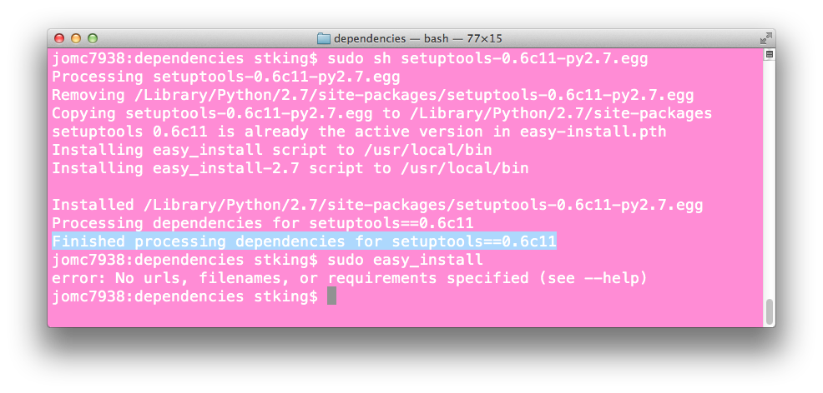

Slide 12
Install PIP (package installer
sudo easy_install --upgrade pip

Slide 13
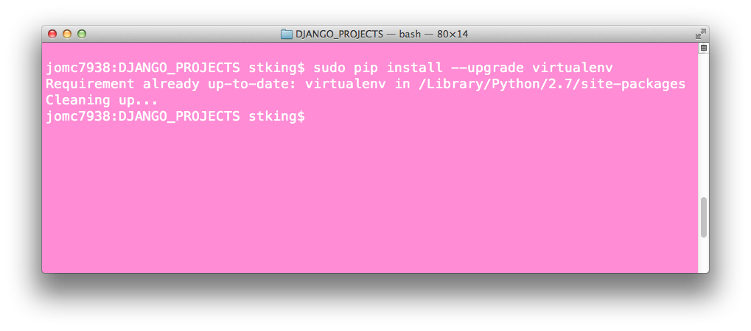
Install virtualenv (Virtual Environment)
sudo pip install --upgrade virtualenv

Slide 14
Understanding Virtual Environments
This is a Sandbox Python Environment
Like a separate server different from your system
You will install packages like Django for each env
Multiple virtual envs for multiple projects
Allows for different versions and setups
Good practice!

Slide 15
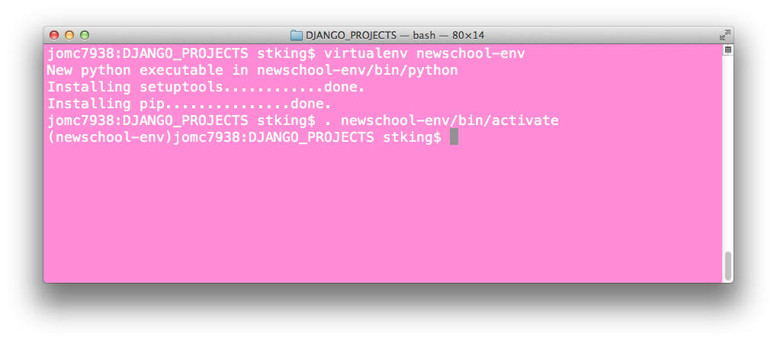
Create your virtualenv
virtualenv newschool-env
. newschool-env/bin/activate

Slide 16
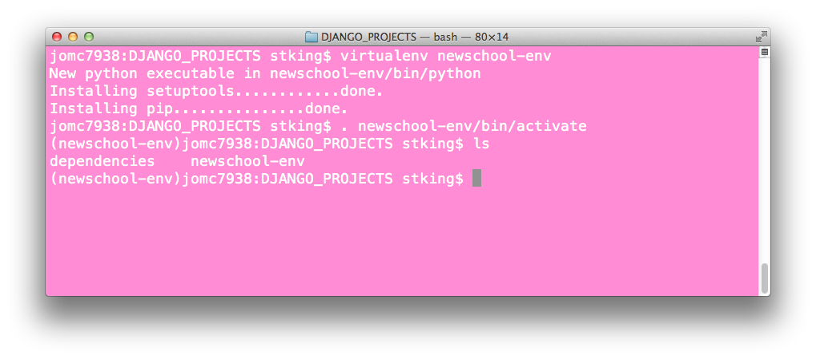
Notice the Prompt
You will do this every time you start a new terminal window to work on a project

Slide 17
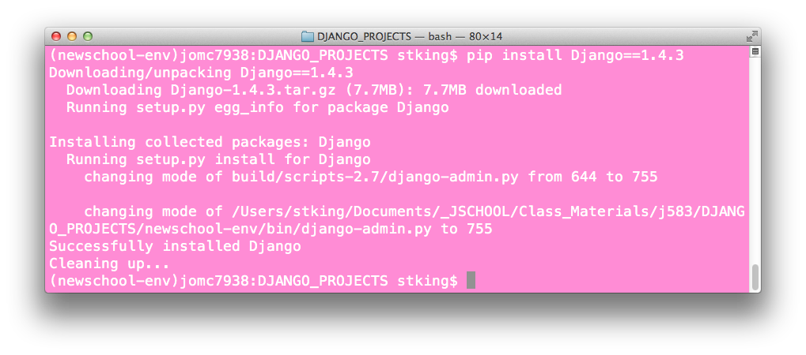
Install Django
pip install Django==1.4.3

Slide 18
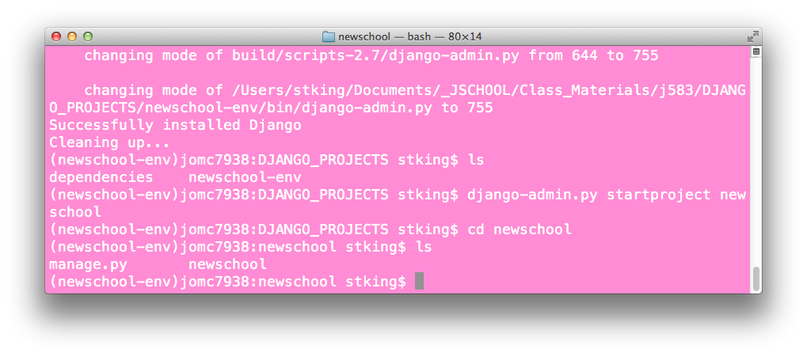
Create a Django Project
django-admin.py startproject newschool
cd newschool

Slide 19
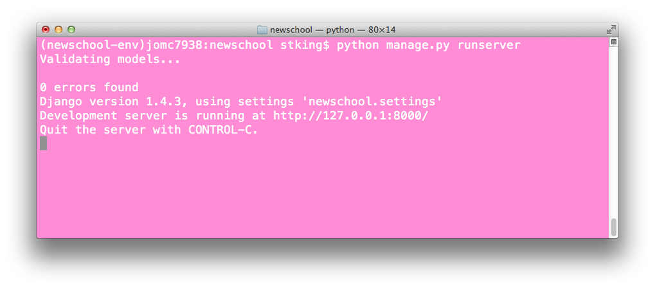
Manage.py
python manage.py runserver

Slide 20
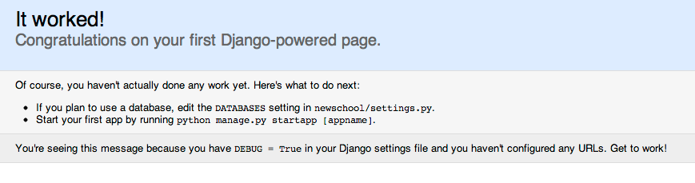
Did it work?
In a browser, go to http://localhost:8000

Slide 21
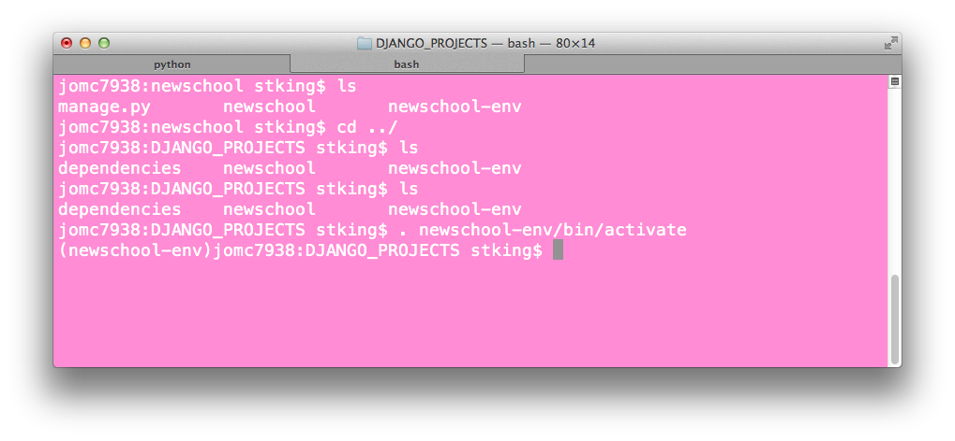
Make your life easier with Tabs
Open a new Terminal tab (Command T on mac)
Restart your virtual env
. newschool-env/bin/activate

Slide 22
Project Files
newschool (dir)
manage.py
newschool(dir)
__init__.py (package file)
settings.py
urls.py
wsgi.py

Slide 23
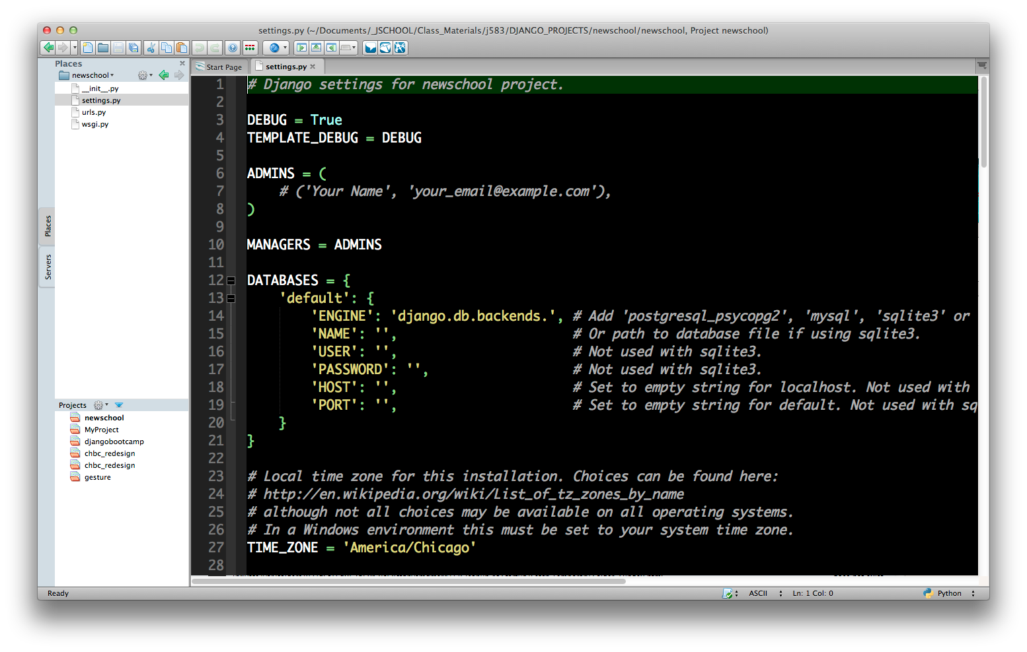
Create a Komodo Project
Save it in your newschool dir

Slide 24
Settings File
These are common settings for Django projects
PROJECT_PATH & PROJECT_ROOT
DEBUG
DATABASES
STATIC_ROOT & MEDIA_ROOT
STATIC_URL & MEDIA_URL
TEMPLATE_DIRS
INSTALLED_APPS

Slide 25
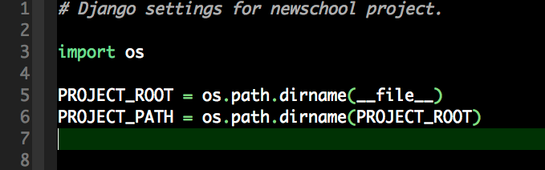
Settings: PROJECT_ROOT and _PATH
Add this to the top of the settings file

Slide 26
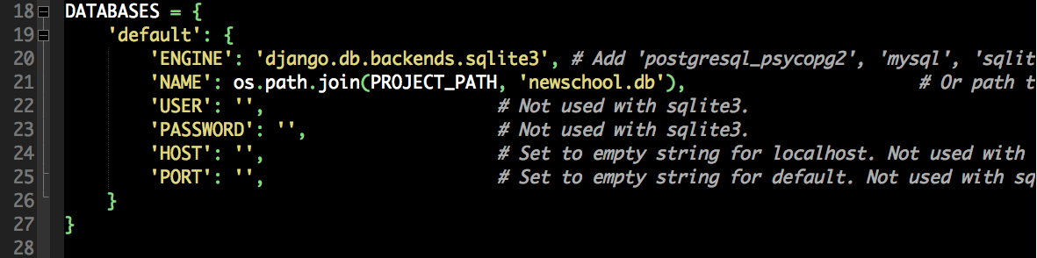
Settings: Database
We will use SQLite
Good for learning
Bad for production
Fine for now

Slide 27
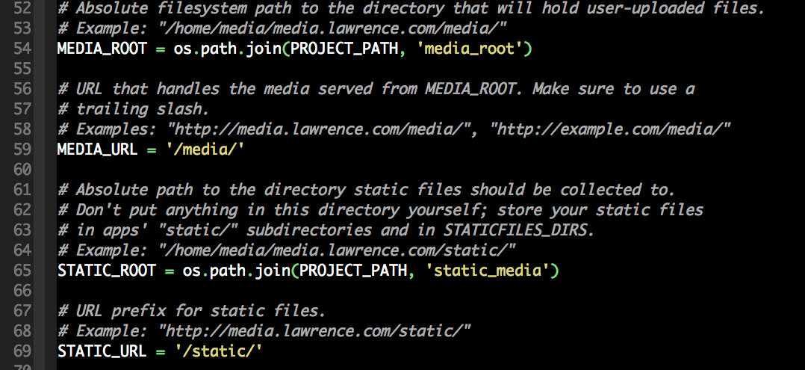
Settings: Paths
Set the media and static paths (4 places)

Slide 28
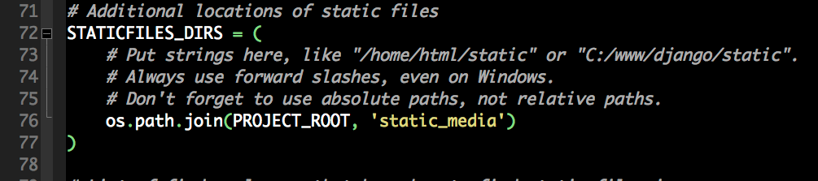
Settings: Static Dir
This is where your CSS and JS files will live

Slide 29
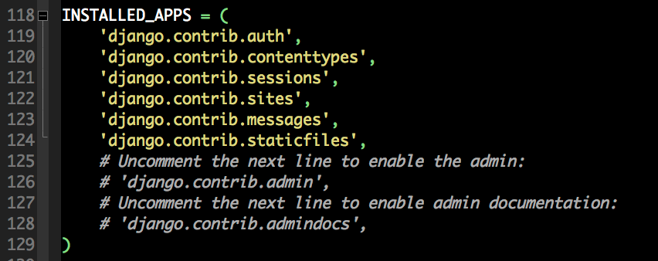
Settings: Installed Apps
Each app must be “turned on” by adding it to the installed apps setting.

Slide 30
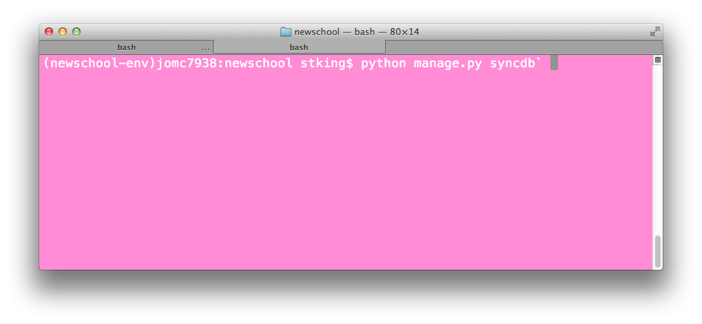
Create database
Run the syncdb to create a database
Creates Superuser
Follow prompts and make a user with simple username and password
Creates database indexes
Install custom SQL
Installed initial data

Slide 31
Check for errors
Check the terminal tab on runserver for errors
Check in browser: http://localhost:8000

Slide 32
App or Project?
App is a set of related functionality (feature)
Ex. User Comments, Admin, Registration
Project is a collection of apps
Project can contain multiple apps and apps can be in multiple project.

Slide 33
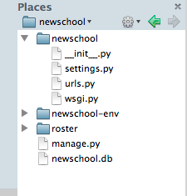
Lets make our first App
python manage.py startapp roster

Slide 34
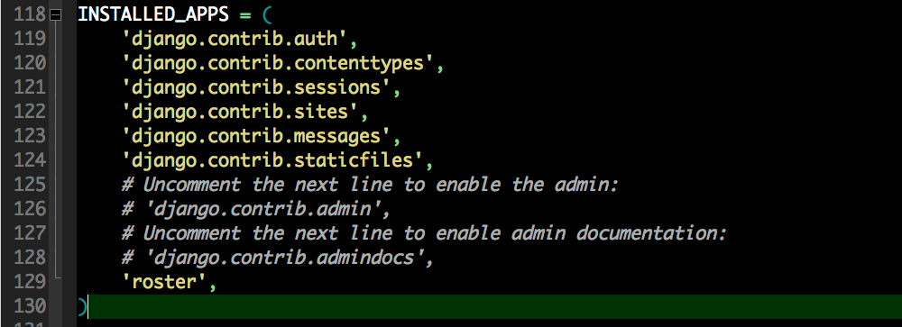
Settings: Add App
Add to bottom of list include comma.

Slide 35
MVT Architecture Pattern
Django follows the Model-View-Template design pattern.
This isolates logic, data and presentation into separate buckets.
Model: Describes the data and how a user interacts with the data (more later)
View: Describes which data user sees
Template: Describes how you see the data

Slide 36
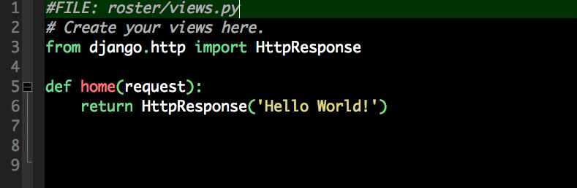
Let’s make a View
Create a Hello World! page
Create a view in the roster app

Slide 37
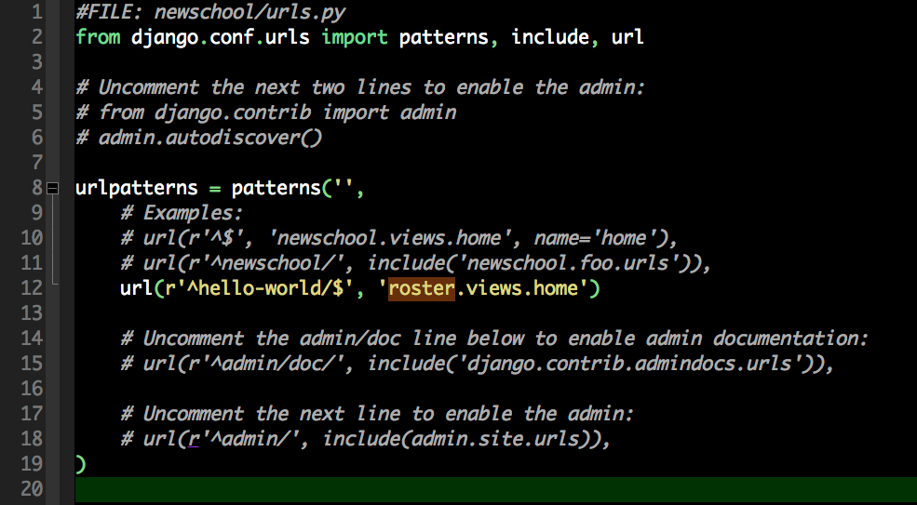
URL Dispatcher
The URL dispatcher connects URLs to Views

Slide 38
Test it!
http://localhost:8000/hello-world

Slide 39
YEA!!!!!! It gets much easier from here!

Slide 40
Intro to Django Part 2
Making Views and Templates

Slide 41
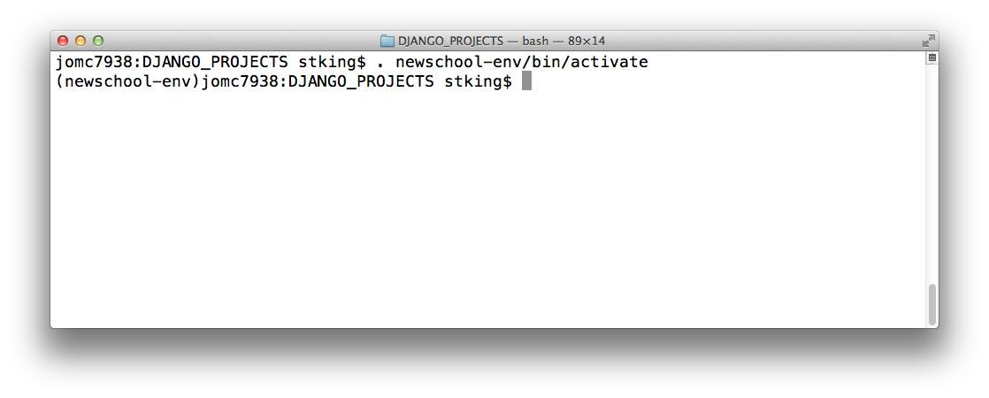
Get in your virtual environment
cd to DJANGO_PROJECTS
. newschool-env/bin/activate

Slide 42
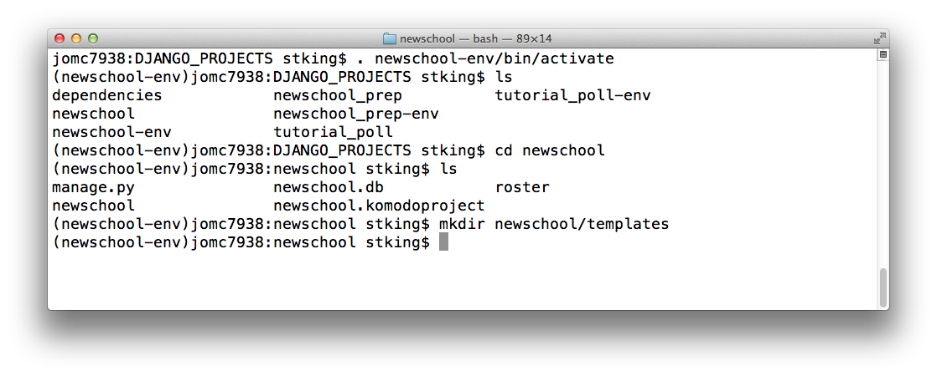
Templates
Lets make a folder to hold our templates
cd inside your project folder (newschool)
mkdir newschool/templates

Slide 43
Create a Template file
touch newschool/templates/base.html
Or, in Komodo, Create from Template – HTML5

Slide 44
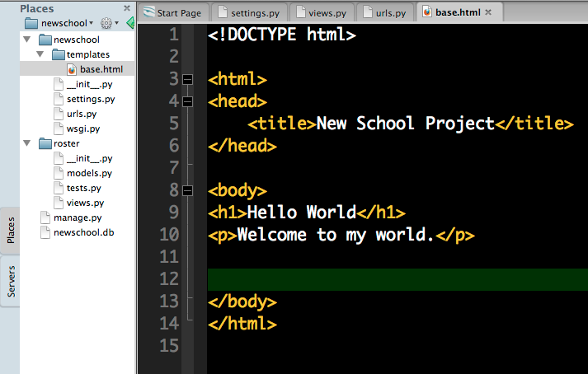
HTML Template

Slide 45
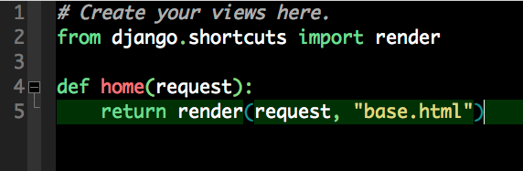
Edit the View

Slide 46
Restart your Server
Open New Tab
. ../newschool-env/bin/activate
python manage.py runserver

Slide 47
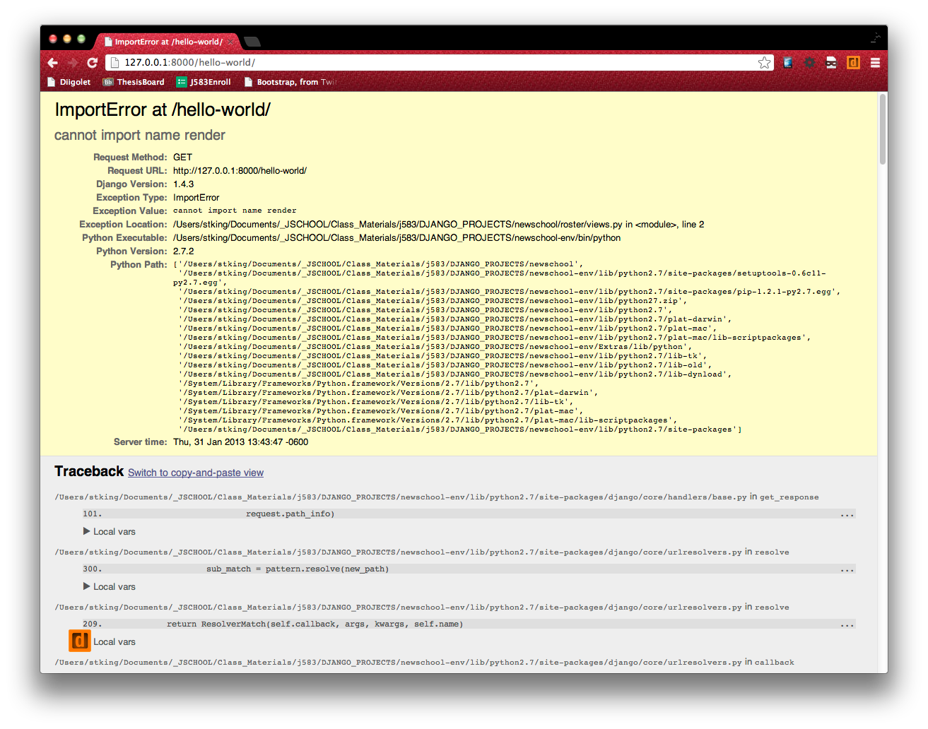
What? Of course it does, I just made it!

Slide 48
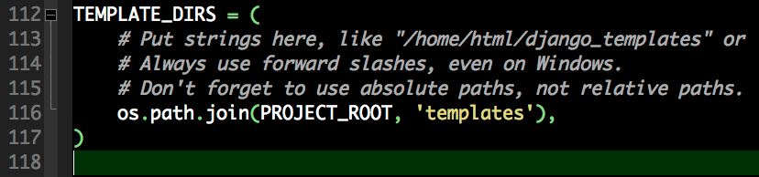
Tell Django where the templates live
Open settings.py and add the template dir

Slide 49
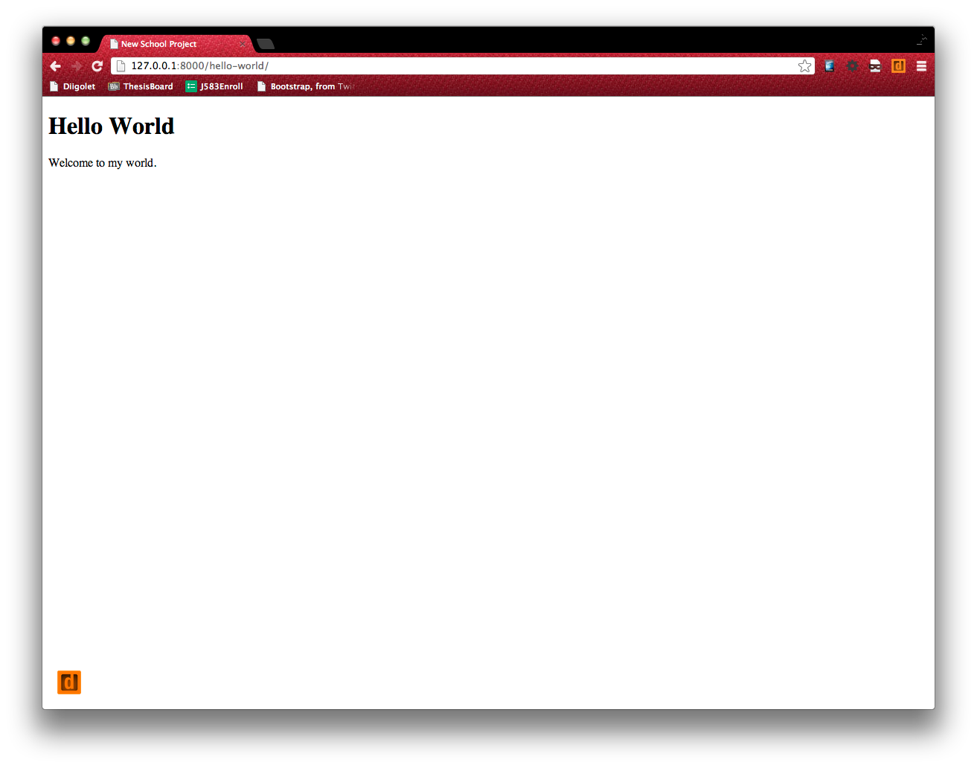
Refresh and See!

Slide 50
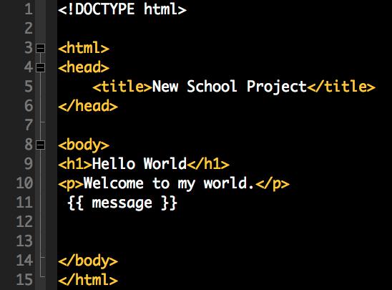
Now let’s do something dynamic!
Edit the Template to add a tag.

Slide 51
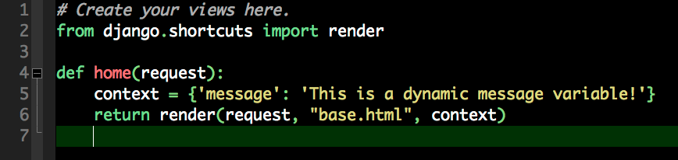
Create a Context
Context is a term used to explain the usage of data

Slide 52
Template Filters and Tags
Templates can also provide ways to change how and when the variables are displayed.
Conditionals: {% if number > 5 %} ... {% else %} ...
Loops {% for elements in iterable %} {% endfo %}
Text Filters: {{ message|lower }}, {{ my_number|floatformate:3 }}

Slide 53
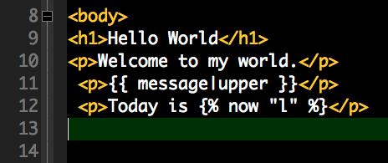
Filter and Tag
Make uppercase and show date.

Slide 54
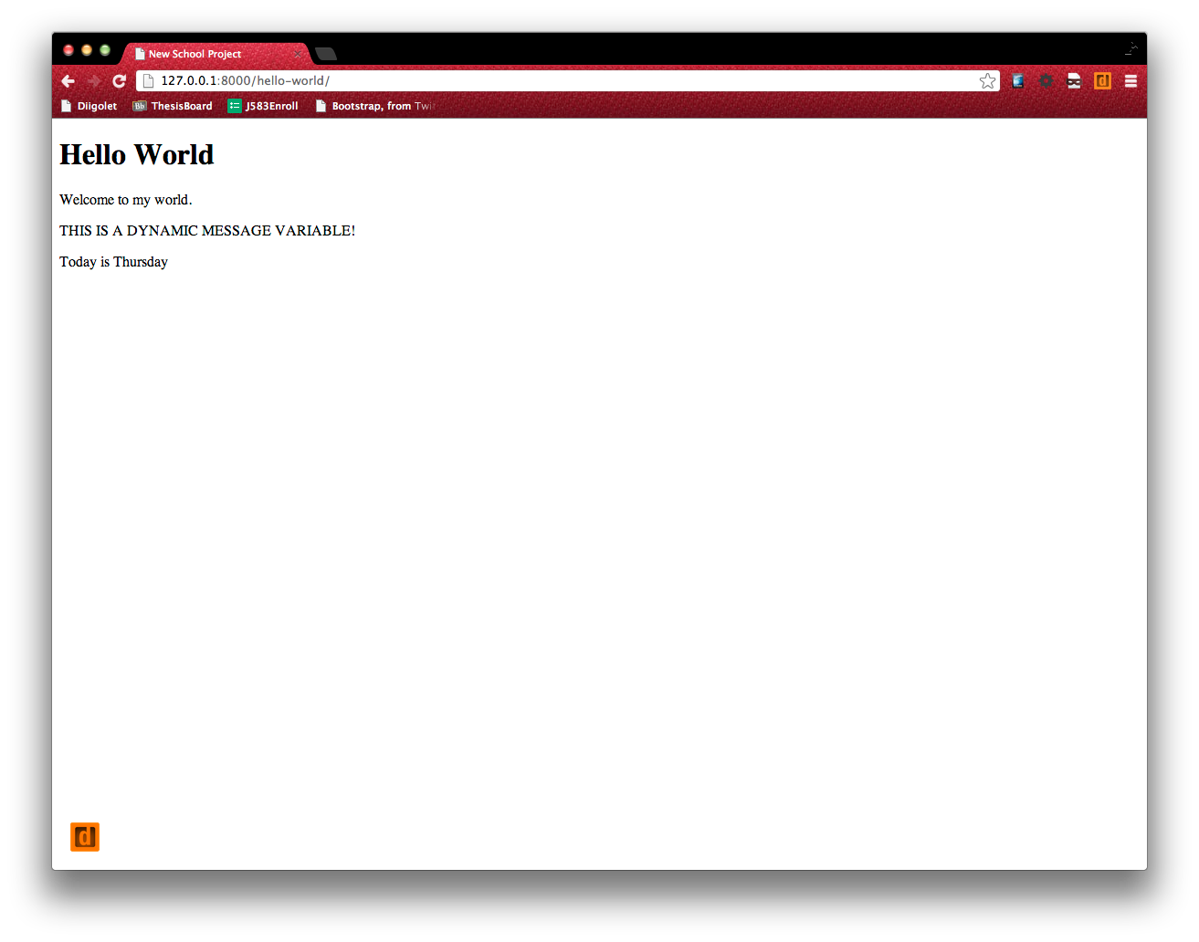
Refresh Browser

Slide 55
That was simple dynamic HTML display
New we need to work with some data.

Slide 56
Models
Models describe our data
Models map to SQL tables
Each table has a name
Column has a specific data type
Django ORM (object-relational-mapper) hides us from real SQL.
Models are important, think them through.
Many ways to model every application

Slide 57
New School App Data
There will be one or many courses (j583)
Courses contains
Title
Course Number
Instructor
Description
Term
Many Students
Name
PID
Email
Photo
Bio
Current Grade
Assignments (Many)
Major

Slide 58
Model
Course
id
Student
id
Assignment
id
points_earned
course_num
name
email
photo
bio
grade
assigments
major
instructor
description
term
title
title
description
points_possible
students

Slide 59
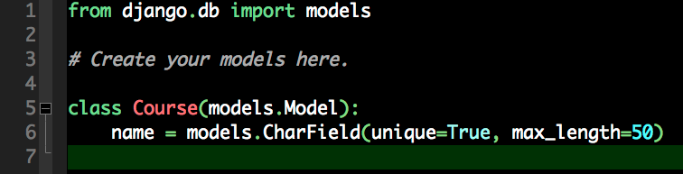
Make your first model

Slide 60
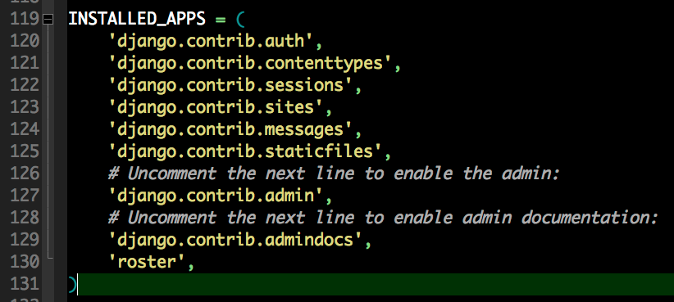
Turn on the Admin App

Slide 61
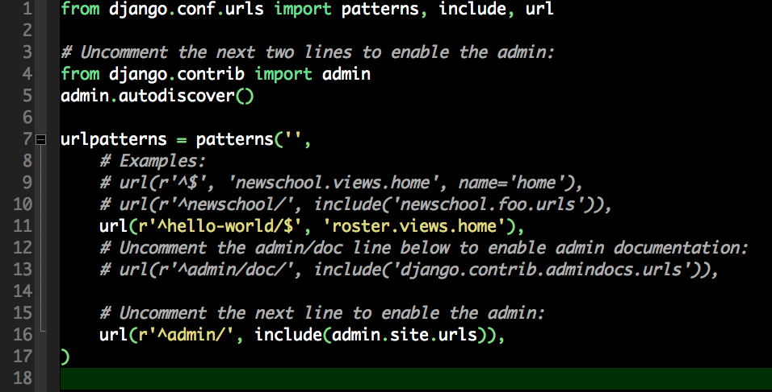
Turn on the Admin URLs

Slide 62
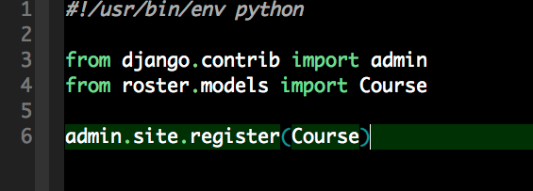
Tell Admin about Course
Create admin.py in the roster dir

Slide 63
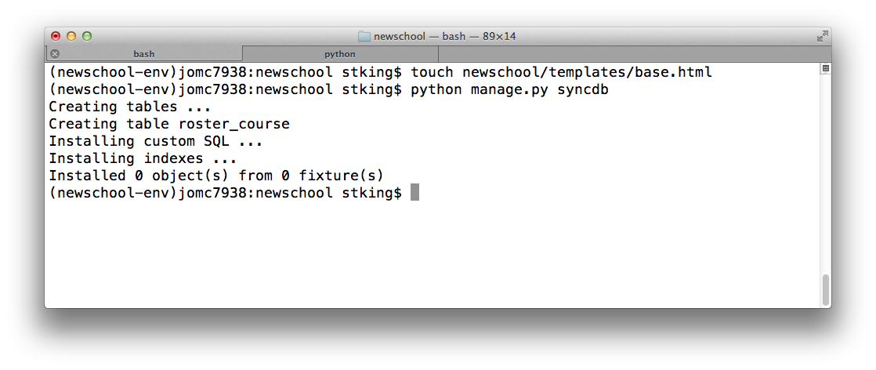
Sync DB
python manage.py syncdb
You have no idea how much time time just saved you!

Slide 64
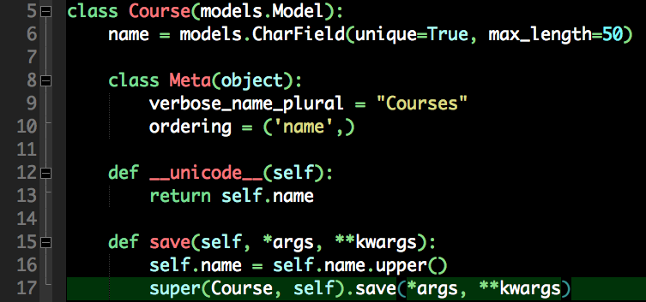
But the Admin needs some work
models.py

Slide 65
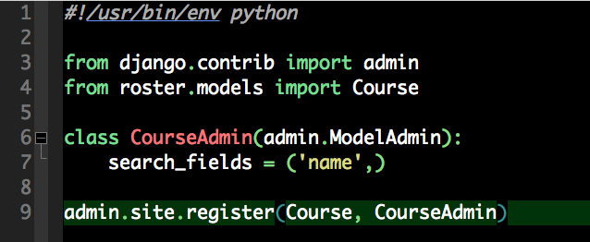
Making Admin better
admin.py

Slide 66
Expand the models
https://docs.djangoproject.com/en/dev/ref/models/fields/
Foreign Key
A unique identifier used to relate tables. Default in Django is the ID.
OneToOne
Similar in concept to Foreign Keys but reverse side returns as single object aswell
ManyToMany
Relation of many FKs. Class has many students.

Slide 67
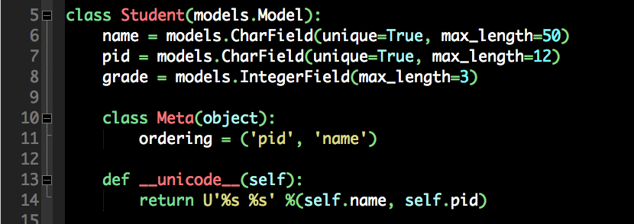
Edit model.py

Slide 68
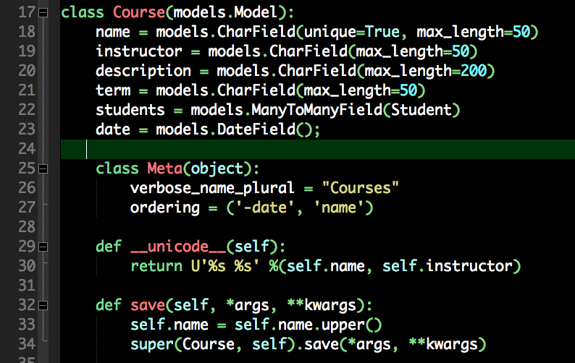
More on models.py

Slide 69
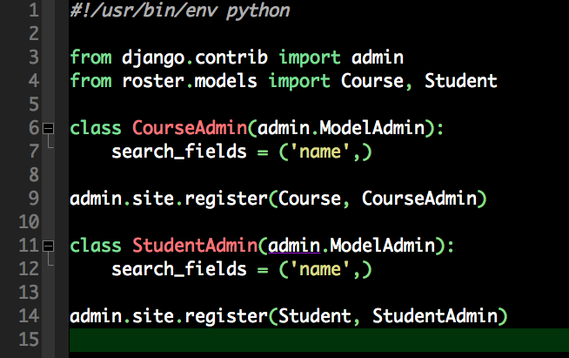
Edit the admin.py file

Slide 70
!

Slide 71
!

Slide 72
!

Slide 73
!

Slide 74
!

